Slide 1

Team: Tech Brewers
Topic: Automated Meeting-Room booking System
Team- Tech Brewers
PPT by Dhruba Das

Slide 2

Team Members:
Anushka Kukreti (Team lead) (45341149)
Dhruba Das (45341107)
Aditi Shah (45341071)
Anupam Sharma (45341179)
Hari Krishna P (45341125 )
Kratika Nema (45341373)
Kanak Yadav (45341291)
Shruti Pandey (45341334)
Vivek Negi (45341177)

Slide 3

Application features
The application creates a very user friendly interface for 1) Employees 2) Managers and 3) admins to efficiently- 1) Book, 2) View and 3) Organise availability of Meeting rooms.
Admins, Employees and Managers all three- get separate homepages with their respective dashboards with essential permissions to view or book or handle meeting rooms with various amenities as listed in the Product Requirement Specification document handed by HSBC Technology Academy for the Code fury contest- 2023.
Exception handling is taken care of- in case there’s illegal
Entry of data. Intensive testing has been conducted to ensure
The application works as intended.

Slide 4

Selling Point of Application (Purpose)
Efficient Resource Utilization: Our App help organizations maximize the use of their meeting spaces by preventing double bookings and ensuring that rooms are utilized to their full potential.
Time Savings: Users can easily check room availability, book, modify, or cancel reservations, saving time that would otherwise be spent coordinating meetings through emails or phone calls.
Streamlined Scheduling: The system provides a centralized platform for managing meeting room reservations, making it simple for employees to find and book the right room for their needs.
Reduced Conflicts: Avoid scheduling conflicts and confusion by having a real-time overview of room availability, which minimizes interruptions and wasted time.
Customization: : Many systems allow organizations to customize booking rules, such as maximum reservation lengths, advanced booking, or recurring meetings, to fit their specific needs.
User-Friendly Interface: Intuitive, user-friendly interfaces make it easy for employees to navigate and book meeting rooms without extensive training.
Visibility: Users can quickly see room amenities, capacity, and location, ensuring that they choose the right space for their meeting requirements.

Slide 5
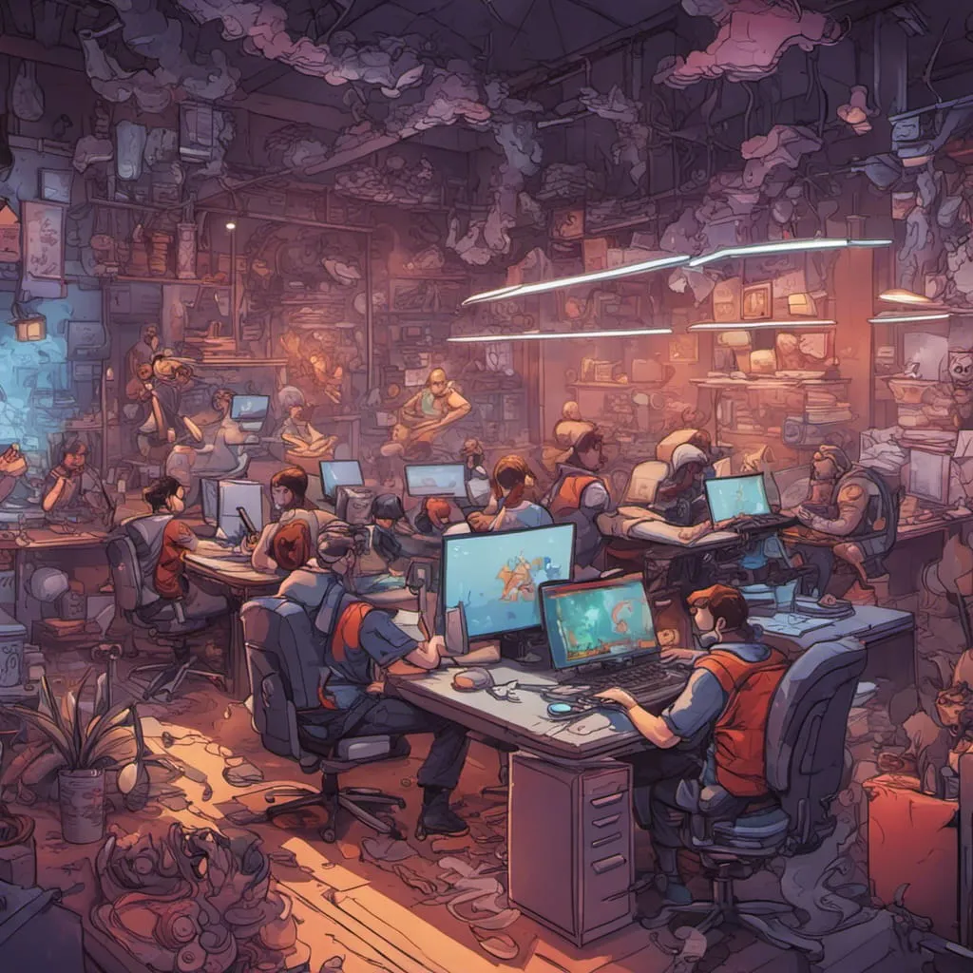
Learnings:
Technical Learnings:
Languages: The 1 week long hackathon helped us strengthen the concepts of Java, SQL, HTML-CSS and Java script that we learnt during the 15 day long bootcamp organised for us by HSBC Learning Academy.
Application: The project helped us apply the theoretical concepts taught in class on an actual hands on project and allowed us to get our hands dirty and let our imaginations run wild creating a project that has real life applications- that would help save organisation both time and money.
Software Engineering: Everyone worked in a team- in a Dev-ops cycle manner where we noted the requirements first, then thought about the design and execution- then went to development and testing- and again circling back to the requirements to see if there's anything additional required- then development, re-testing and then finally submission~!

Slide 6
Learnings
Non-Tech Learning:
Teamwork and Collaboration: The Hackathon involved working in a team. We learnt how to collaborate effectively, delegate tasks, and leverage each team member's strengths to achieve a common goal. Effective communication was crucial
Problem-Solving: The Hackathon presented a real-world requirement that required a creative and innovative solution. We learnt to think critically, analyze issues, and develop a practical solution within this one week.
Time Management: Given the time constraints of the hackathon, we learnt to prioritize tasks, set goals, and manage time efficiently to meet project deadlines.
Adaptability: The fast-paced nature of hackathon required us to adapt quickly to changing circumstances, reevaluate strategies, and make adjustments as necessary.
Networking: We had the opportunity to connect with our SPOC- Liqzan Manna, and other team members during the hackathon. Networking can helped us to build valuable relationships for future collaborations and career opportunities.
Resilience: We had to face challenges and setbacks during the hackathon. We learnt how to stay motivated, persevere through difficulties, and maintain a positive attitude.

Slide 7

Concepts used
Coding with the following Technologies:
HTML
CSS
Java
Javascript
JDBC Connections
MySQL
Bootstrap

Slide 8
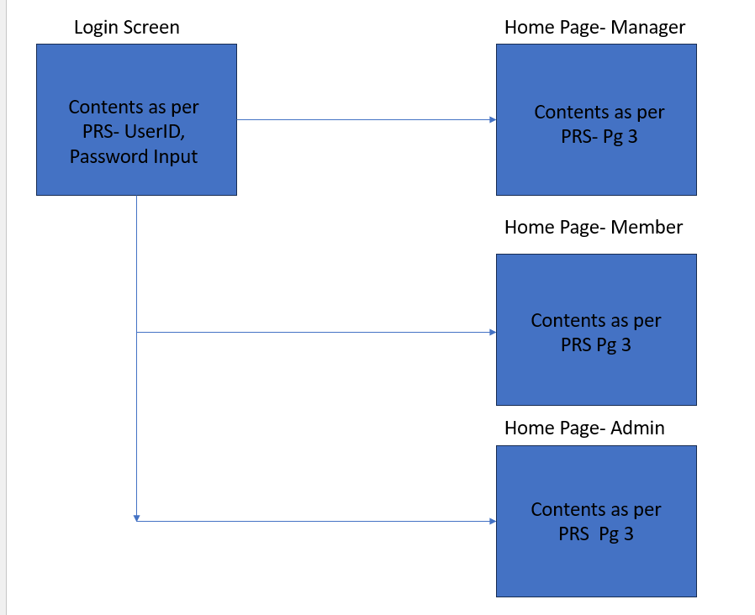
Front End Structure

Slide 9

Collaboration
During the hackathon, we had the opportunity to connect, network, and discover each other's strengths.
Anushka displayed exceptional leadership skills, effectively assigning tasks and managing any conflicts that arose to ensure the project's smooth operation.
In the back-end, Anupam, Aditi, and Dhruba demonstrated their proficiency in handling Java and SQL components seamlessly.
Hari Krishna, Shruti, Aditi, Kratika and Anupam, were responsible for the frontend, delivering an elegant design for our Meeting Room Automation system.
We collaborated as a team to bring this project to fruition and meet the submission deadline. Anushka, Kanak, and Dhruba focused on documenting the project to ensure its readability and accessibility to all users. Kanak helped with the Use Case diagram, and Vivek with the RDBMS diagram.
Anushka conducted comprehensive testing to guarantee a flawless final product.

Slide 10
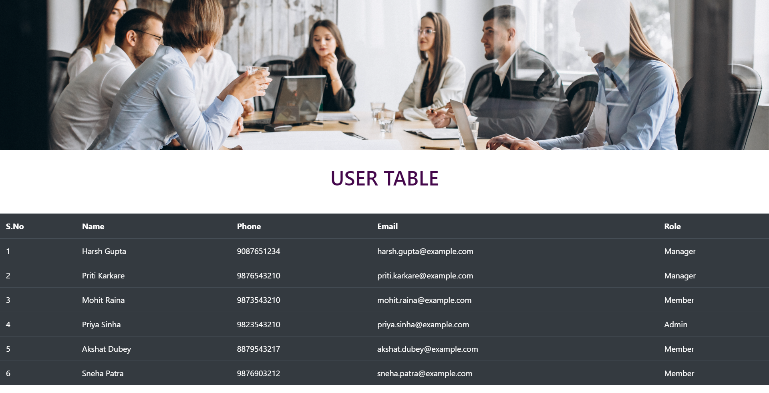
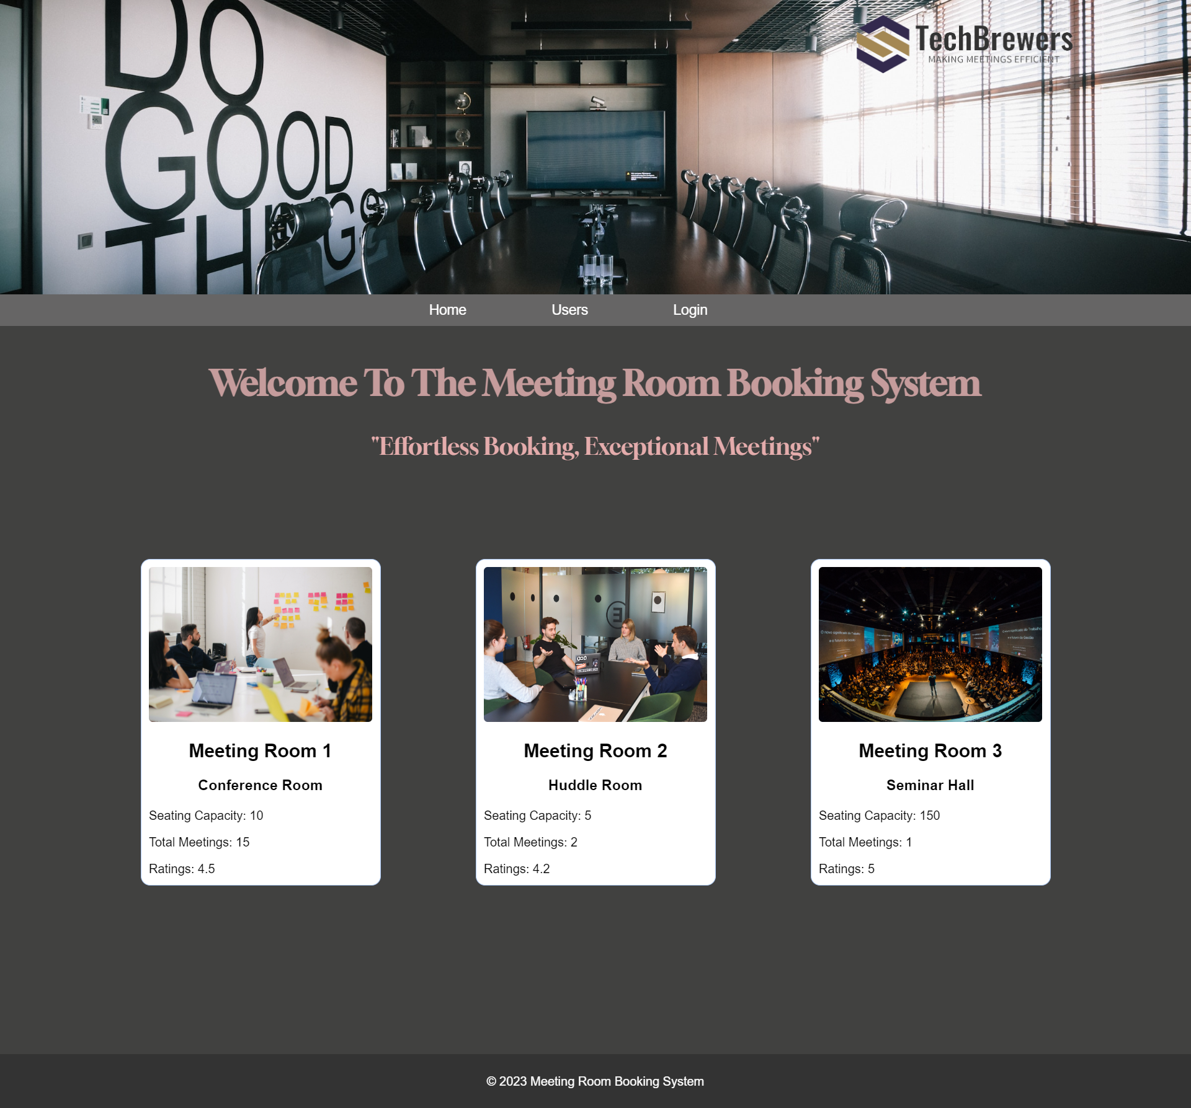
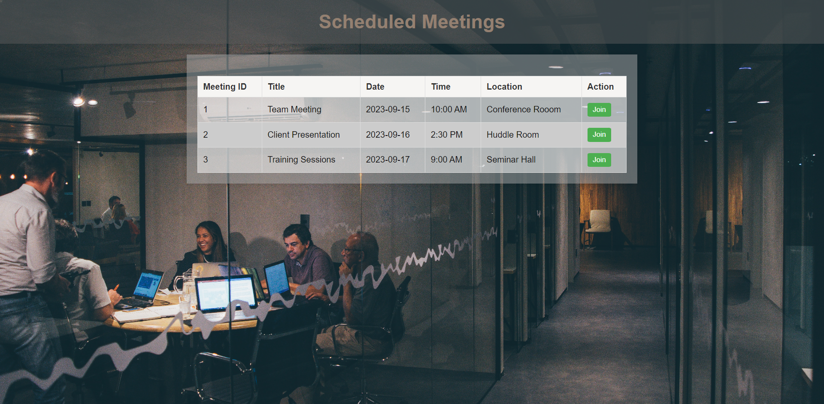
UI Screenshots

Slide 11
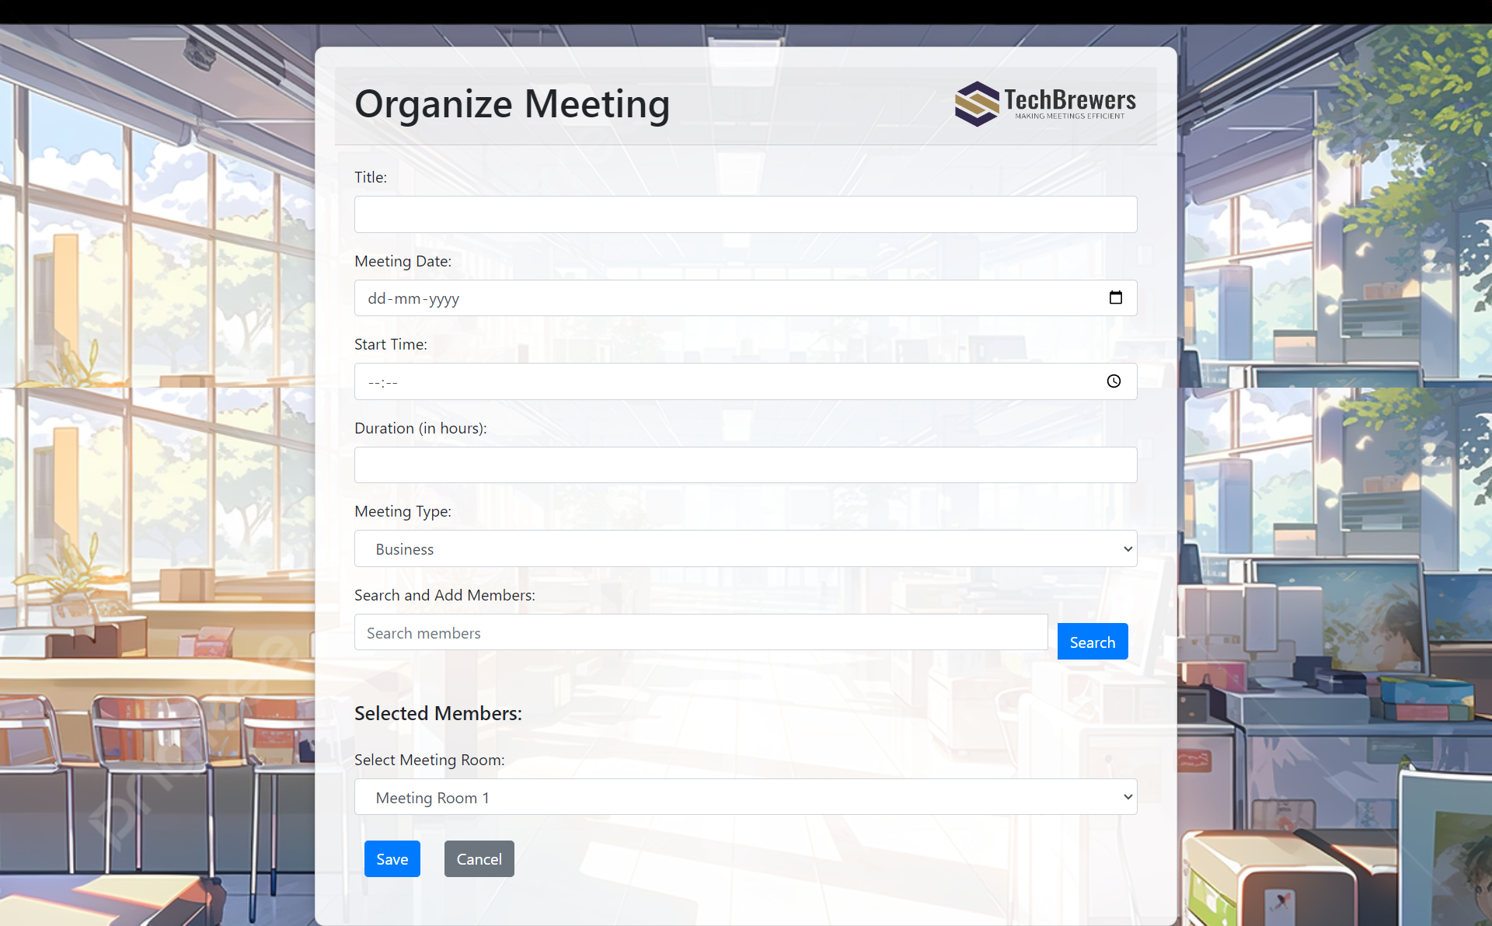
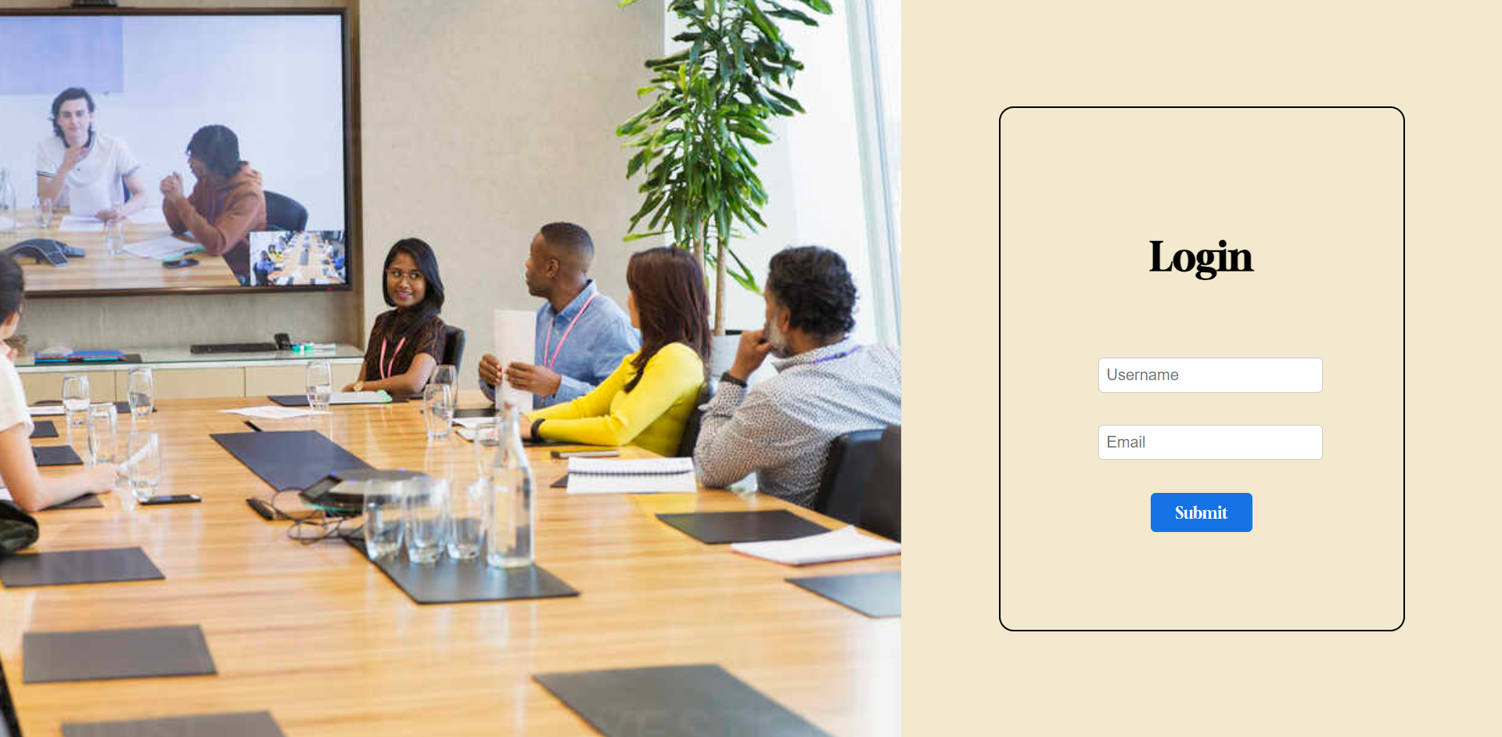
UI Screenshots- Contd

Slide 12
Future Development Ideas
Integration: Integration with calendars (e.g., Outlook, Google Calendar) ensures that meeting room reservations are seamlessly incorporated into users' existing schedules.
Resource Optimization: Some systems offer data analytics and reporting features to help organizations identify underutilized meeting spaces and optimize room allocation.
Accessibility: Many systems offer mobile apps or web-based access, allowing employees to book rooms from anywhere, further enhancing convenience.

